Slide 1
Capstone Project - The Battle of Neighborhoods
Selecting the best location to open an IndIAN RESTAURANT IN, New York

Slide 2
Introduction/Business Problem
The City of New York is famous for its excelllent cuisine. It's food culture includes an array of international cuisines influenced by the city's immigrant history.
Indian restaurants have become so popular in the United States now it seems that there is one on every corner, not only in major cities but also in smaller cities. Starting a Indian restaurant can be a great business opportunity, but you need to distinguish yourself from others to enjoy long-term success.

Slide 3
Business Problem
My client wants to open his business in Manhattan area, so I focus on that borough during my analysis. We define potential neighborhood based on the number of Indian restaurant which are operating right in each neighborhood. Manhattan has full potential but also is a very challenging district to open a business because of high competition. New Indian restaurant should be open in an area that inadequate neighborhood in this way the bar can attract more customers. Therefore, this analysis necessary to ensure that we have enough customers and that we are not so close to other Indian places.

Slide 4
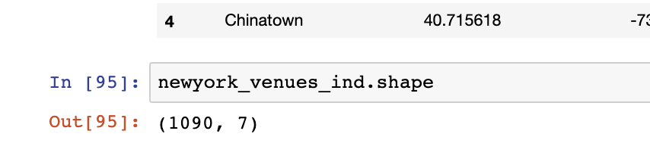
Data Selection
To identify the characteristics of our competitors' venues in Manhattan, we would first need to find out the number of Indian restaurrant in Manhattan currently and their location.
We then used Google Map API to find their geographic coordinates based on their postal code addresses.
In Manhattan, there is 1090 Indian restaurant are currently operating.

Slide 5
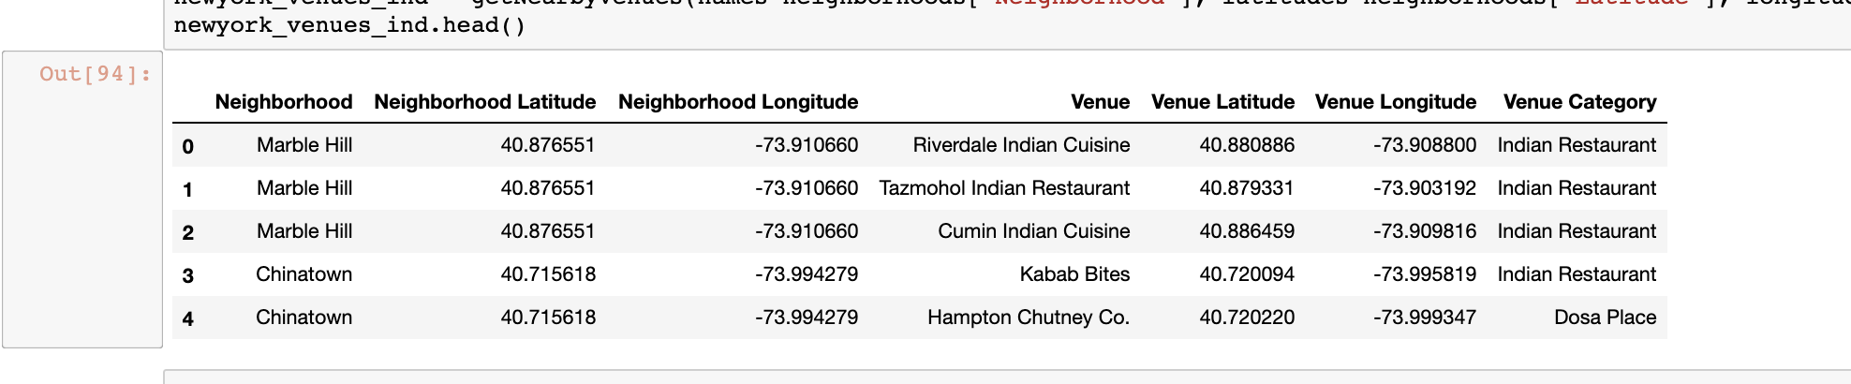
Data Selection
Next, we also used Google Map API to find their geographic coordinates of the 5 locations shortlisted for our Indian restaurant:
Table 2: Data frame containing geographic coordinates of our 5 shortlisted locations

Slide 6
Methodology
Addresses are converted into their equivalent latitude and longitude values.
Foursquare API is used to explore neighborhoods in Manhattan, New York.
After that, explore function to get sushi restaurant categories in each neighborhood.

Slide 7
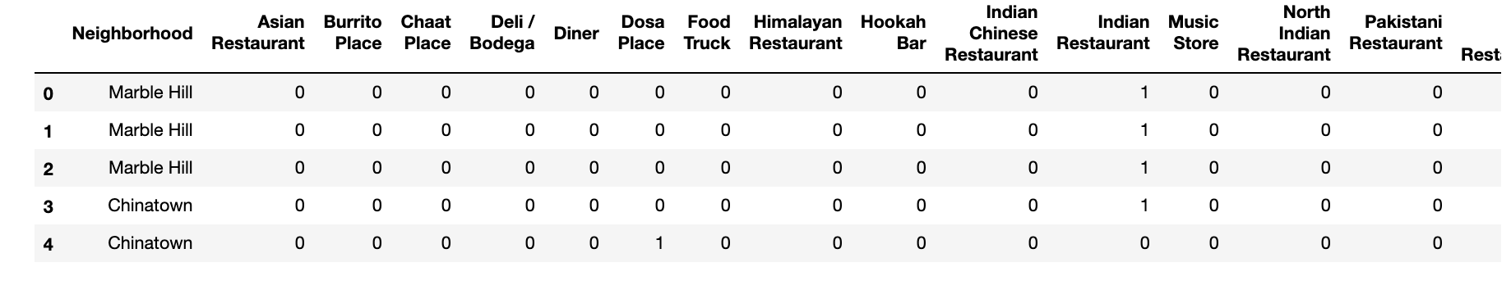
Methodology

Slide 8
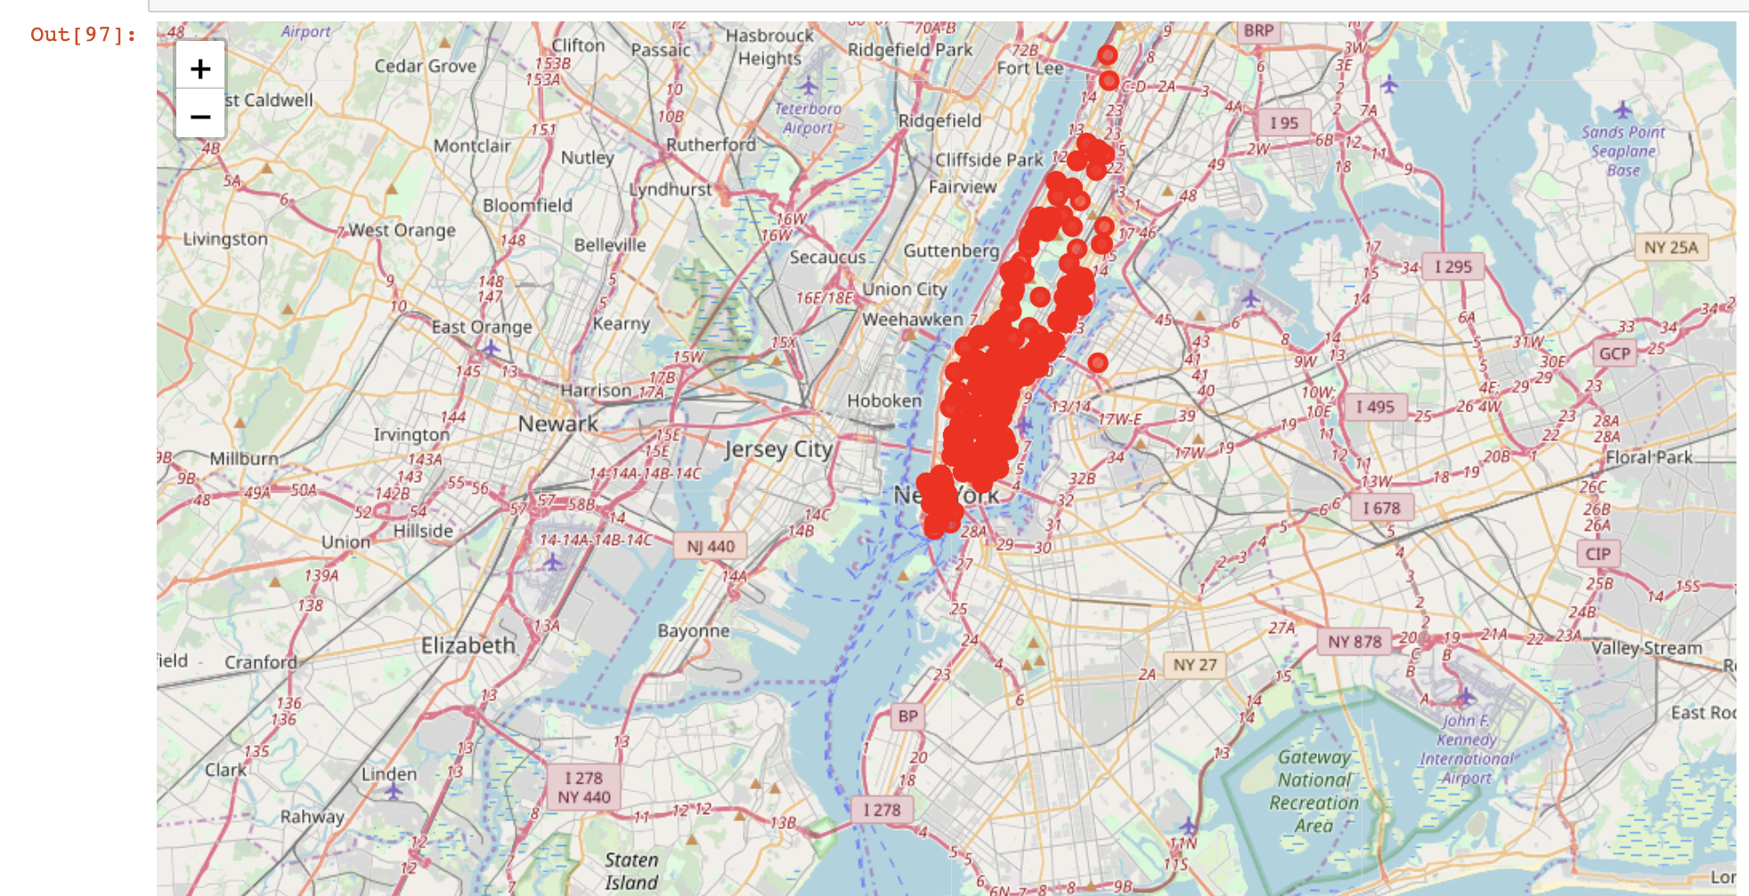
Methodology
Indian restaurant in Manhattan

Slide 9
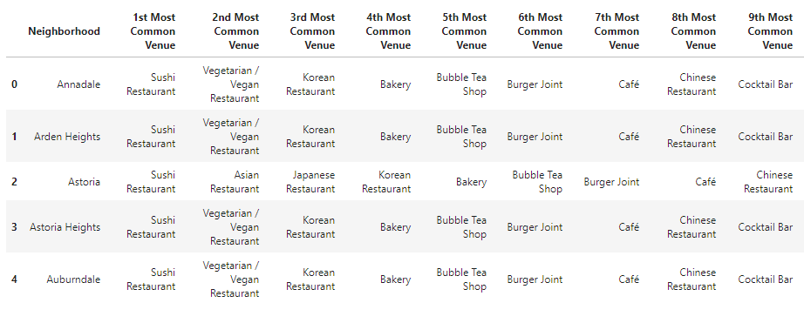
Methodology
Then using this feature to group the neighborhoods into clusters K-means clustering algorithm will be use to complete this task. And also, the Folium library to visualize the neighborhoods in Manhattan and its emerging clusters.

Slide 10
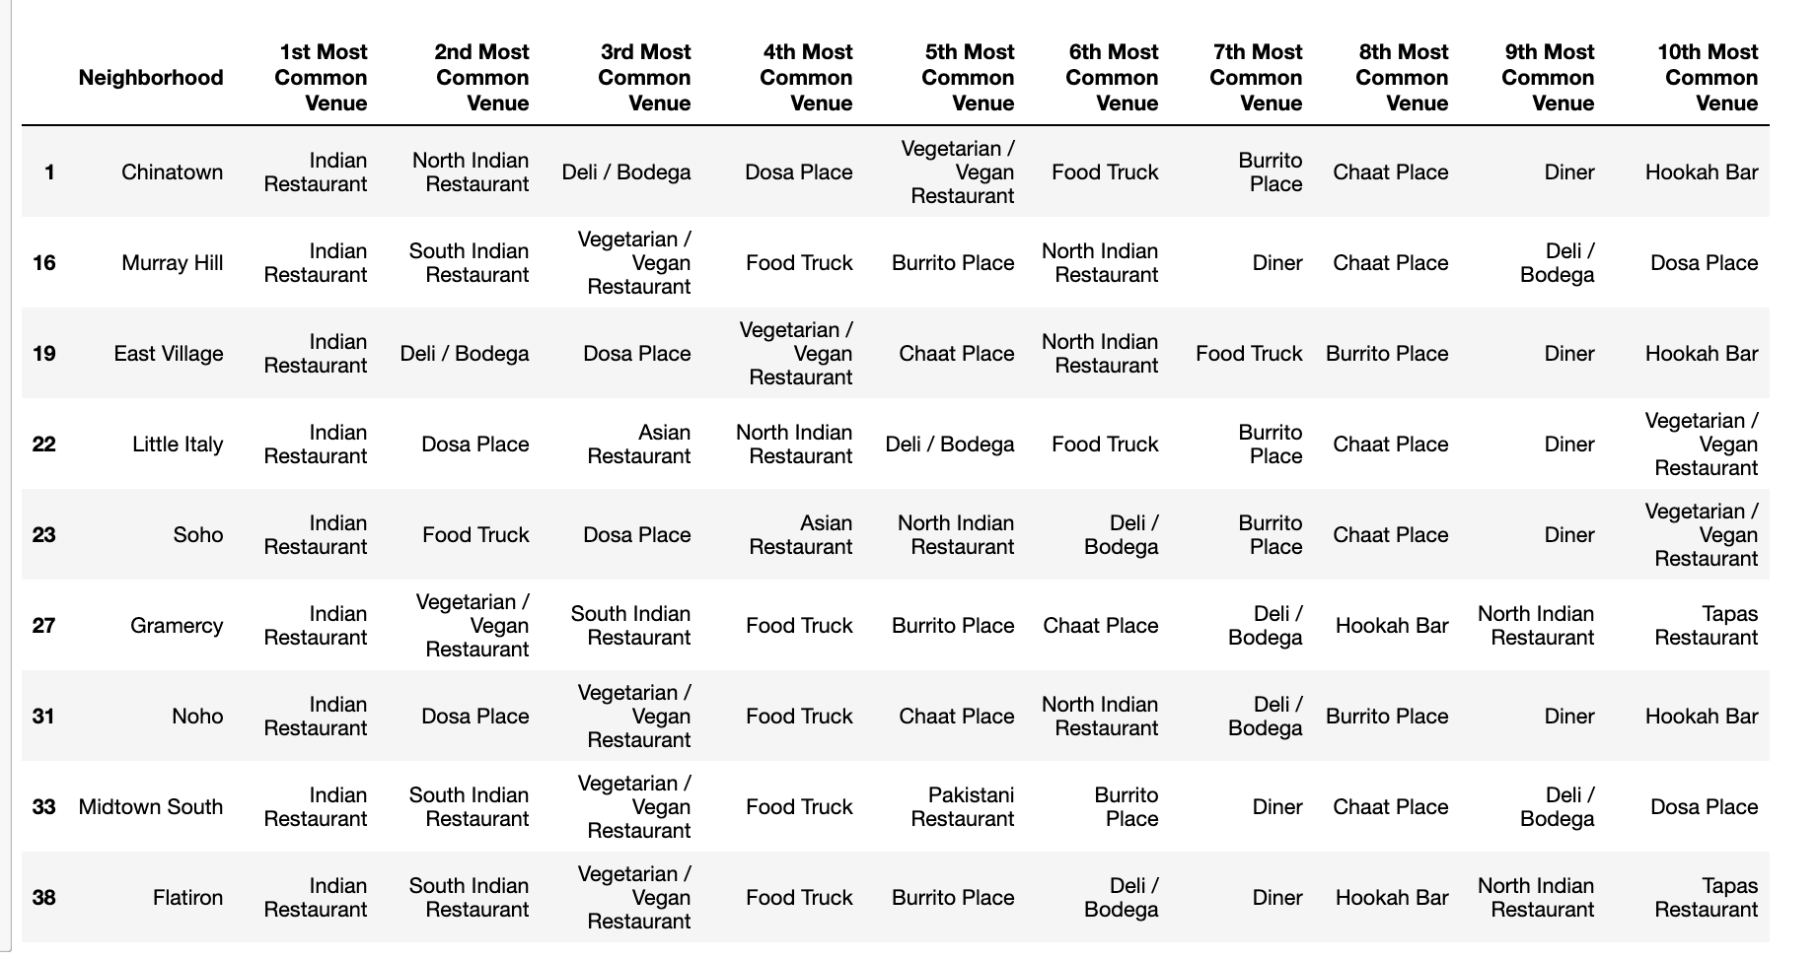
Results
Using K-mean to clustering data area with less number of sushi bars
Cluster 0

Slide 11
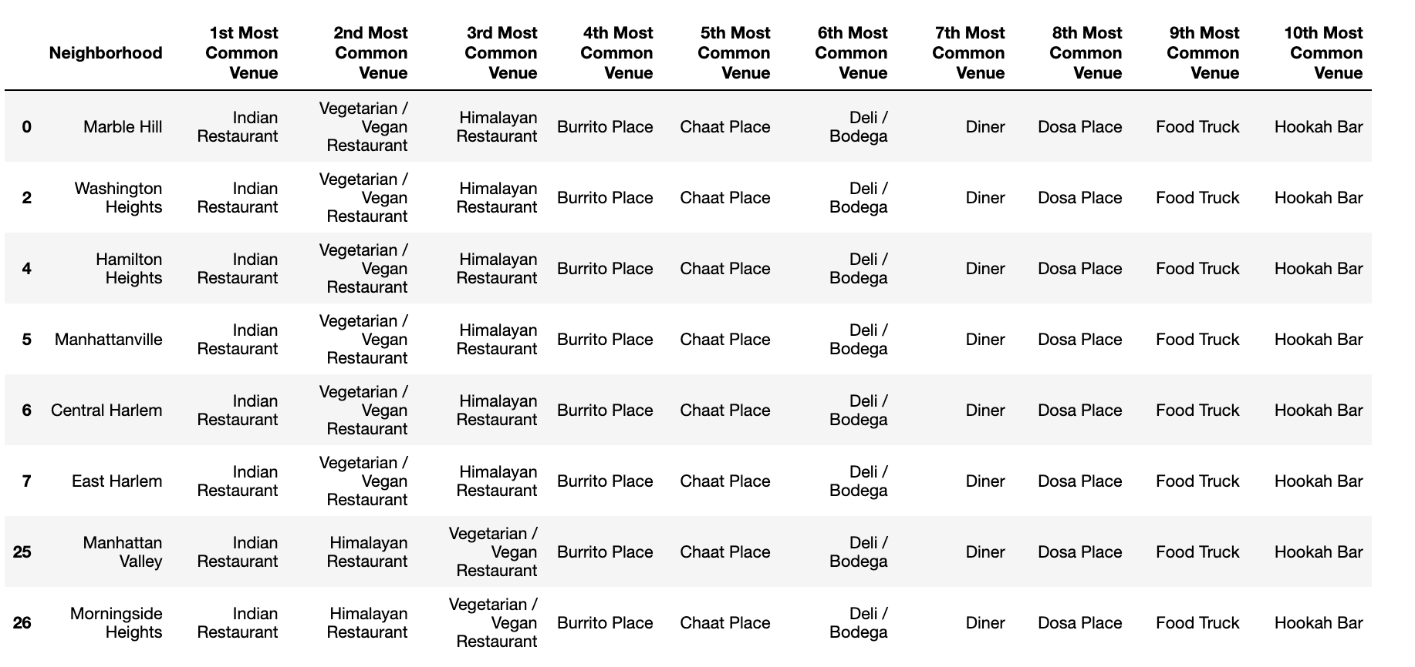
Result
Cluster 1

Slide 12
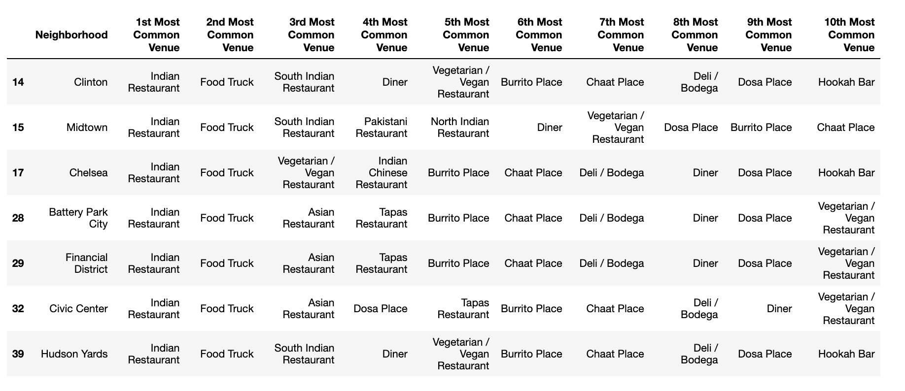
Result
Cluster 2

Slide 13
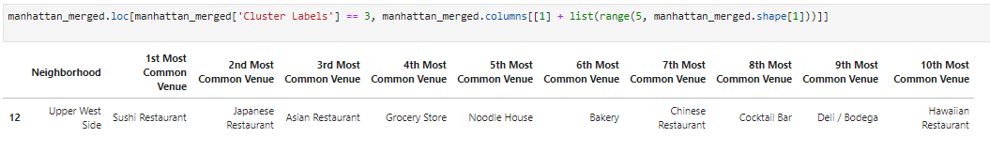
Result
Cluster 3

Slide 14
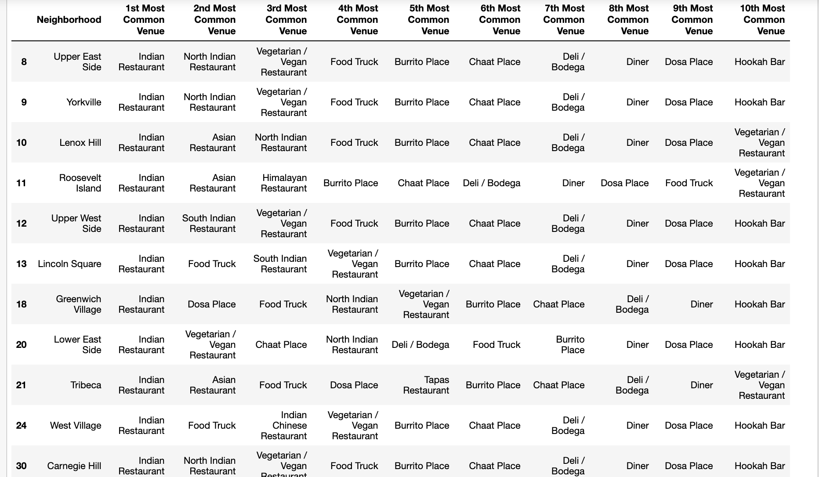
Result
Cluster 4

Slide 15
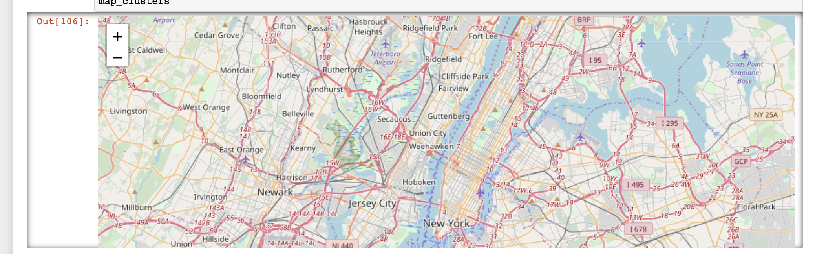
Result
Based on dataframe analysis above Cluster 3 area is the best places to open a new Indian restaurant business.

Slide 16
Discussion
Below are discussion points
There is high competition in other areas so risky tto open restaurant
It can be done more detailed analysis by adding other factors such as transportation, demographics of inhabitants.
FourSquare proved to be a good source of data Finally, FourSquare proved to be a good source of data but frustrating at times. Despite having a Developer account I regularly exceeded my hourly limit locking me out for the day

Slide 17
Conclusion
Although the project recommended the location but still there is room for improvement but still the goal to identify a location was made possible

